Slide 1

International CLIVAR Plans
Lisa Goddard, Detlef Stammer

Slide 2









International Science Organization
Global Environmental Change Programs
World Climate Research Program’s Projects
Notes:
See p. 2 of Draft IP
2

Slide 3
SPARC
Ocean Tropo- Strato-
sphere sphere
CLIVAR
GEWEX
CliC
Cryosphere
Land

Slide 4
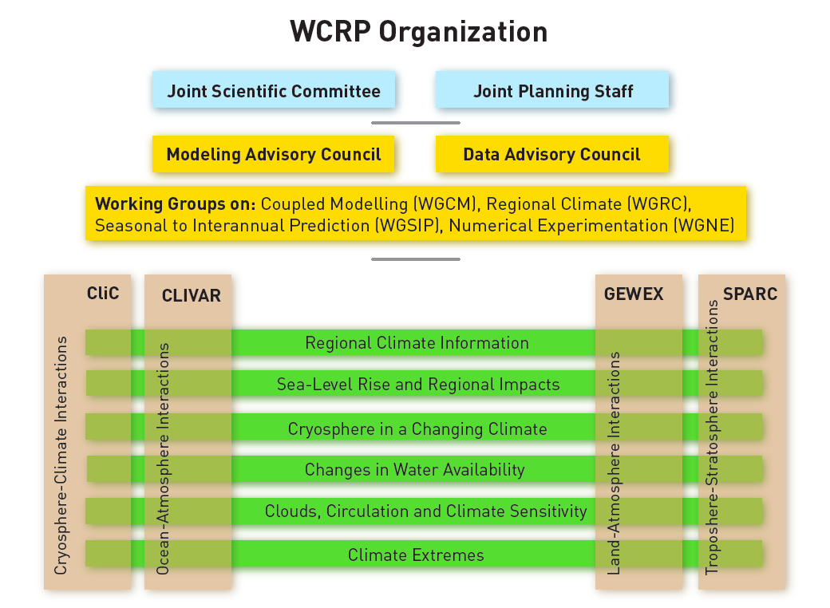

WCRP Grand Challenges

Slide 5
CLIVAR OCEANS & CLIMATE
variability, predictability and change
    WCRP’s core project to on the
    Ocean-Atmosphere System
    its understanding and prediction
    and its influence on climate variability and change,
    to the benefit of society and the environment.

Slide 6

CLIVAR Research Foci
Intraseasonal, seasonal and interannual variability and predictability of monsoon systems
Decadal variability and predictability of ocean and climate variability
Trends, nonlinearities and extreme events
Marine biophysical interactions and dynamics of upwelling systems
Sea level changes and regional impacts
Consistency between planetary heat balance and ocean heat storage
ENSO in a warmer world

Slide 7
CLIVAR Research Foci
Science and work plans are currently designed and reviewed by JSC or SSG.
Outcome of planning process available later this year.
Participation by community intended (please contact leads of research foci).
Proposals for new research foci possible.

Slide 8
Examples of Research Foci
Peter Brandt: Marine biophysical interactions and dynamics of upwelling systems
Catia Domingues: Sea level changes and regional impacts
Wenyu Cai: ENSO in a warmer world

Slide 9
CLIVAR Scientific Steering Group
ICPOs
Core Panels Research Foci
Ocean Model Development Panel
Predictability
of monsoon systems
Global Synthesis and
Observations Panel
Decadal climate variability and predictability
Climate Dynamics Panel
Biophysical interactions and dynamics of upwelling systems
Atlantic Region Panel
Pacific Region Panel
Regional
sea level changes and impacts
Indian Ocean Region Panel
Prediction and attribution of extreme events
Southern Ocean Region Panel
ENSO in a warmer climate
Monsoons Panel
Planetary heat balance & ocean heat storage
ETCCDI
…
Knowledge Exchange and Capacity Building Panel

Slide 10

CLIVAR Capabilities
Improving the atmosphere and ocean component of Earth System Models.
Implementing innovative process and sustained ocean observations.
Facilitate free and open access to climate and ocean data, synthesis and information.
Support Regional and global networks of climate and ocean scientist.
Facilitate knowledge exchange and user feedback.
Support education, capacity building and outreach.

Slide 11






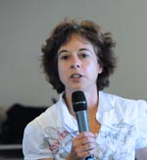







Scientific Steering Group Members
Dr. Lisa Goddard
(co-chair 2015)
Earth Institute at Columbia, USA
Detlef Stammer
(co-chair 2016)
CEN, Universiy Hamburg
Dr. Annalisa Bracco (2015)
School of Earth & Atmospheric Sciences, Atlanta, USA
Dr. Ken Drinkwater (2014)
Institute of Marine Research, Bergen, Norway
Dr. Sergey Gulev (2014)
Russian Academy of Sciences, Moscow, Russian Federation
Dr. Ed Hawkins (2015)
Department of Meteorology, University of Reading, UK
Dr. Pascale Braconot (2016)
CEA-CNRS, France
Professor Martin Visbeck (past Co-chair 2014)
GEOMAR, Kiel, Germany
Dr. Steve Rintoul (2013)
CSIRO, Australia
Dr. Pedro MS Monteiro (2015)
CSIR, South Africa
Dr. Sigfried Schubert
(2014)
NASA Goddard Space Flight Centre
Dr. Lixin Wu (2015)
Ocean University of China, China
Dr. Stephen Griffies (2016)
NOAA-GFDL, Princeton
Dr. Carlos Moffat (2016) University Concepcion – Chile

Slide 12


Transition of CLIVA project office:
from UK to 3 node structure
ICPO
NOC UK
ICPO Global
(China)
ICPO Modeling (Italy)
ICPO Monsoon (India)
Executive Director
Notes:
Thanks SSC

Slide 13

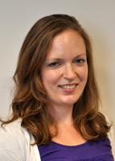



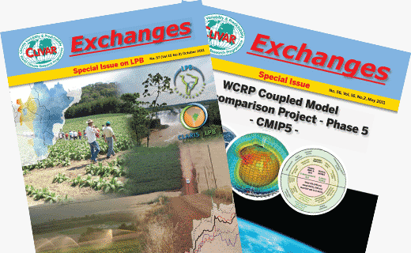





International CLIVAR Project Office (ICPO)
Roger Barry
Director
Jennifer Riley
Staff Scientist
Valery Detemmerman
WCRP JPS
Nico Caltabiano
Staff Scientist
Carlos Ereño
Staff Scientist
Anna Pirani
Staff Scientist
Xiaohui Tang
Staff Scientist
www.clivar.org
Notes:
Thanks SSC

Slide 14
Early Career Scientists Draw:
Please fill out early career scientist forms!!
Everybody gets a book!
The winner gets a free participation in the Le Hague pan-CLIVAR Meeting

Slide 15
More CLIVAR Information
Pan CLIVAR Meeting: Le Hague, July 14 – 18.
Joint session with GEWEX
Open Call for nominations for all panel membership

Slide 16
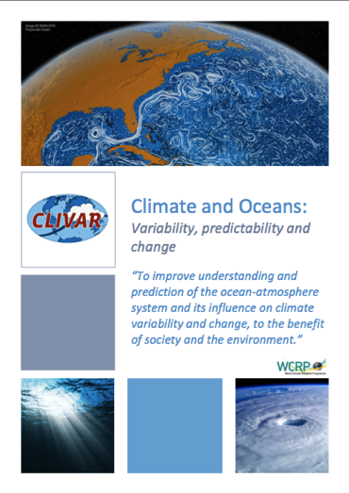
For more information:
CLIVAR OCEANS & CLIMATE
variability, predictability and change
    To improve understanding and prediction
    of ocean-atmosphere system
    and its influence on climate variability and change,
    to the benefit of society and the environment.
www.clivar.org

Slide 17
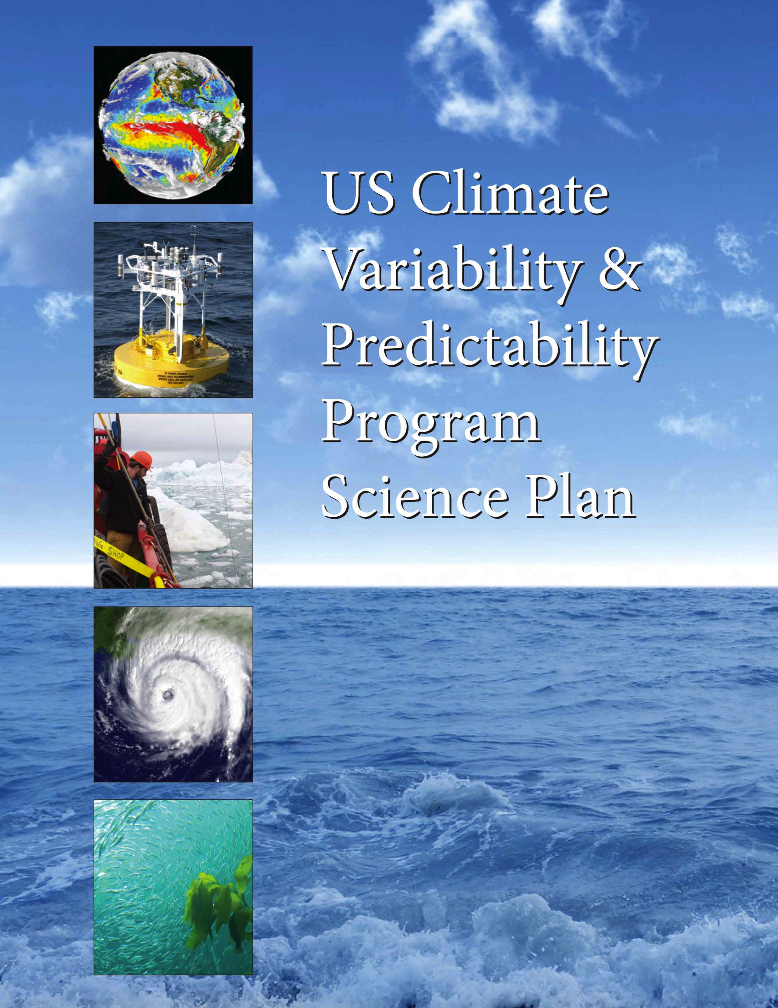
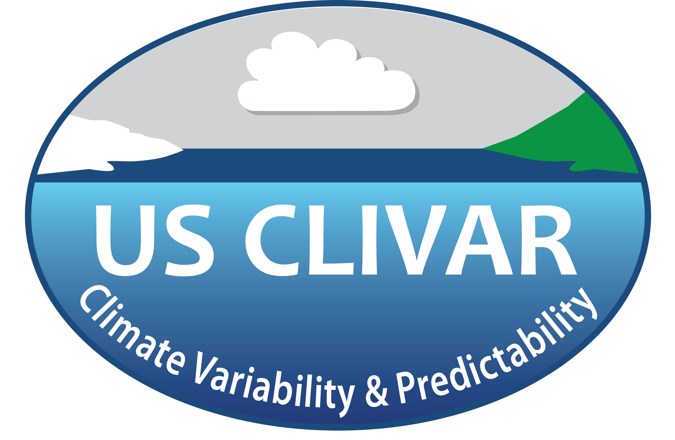
US CLIVAR
Science Plan
Lisa Goddard
(on behalf of Bob Weller, Chair)
http://www.usclivar.org/sites/default/files/US_CLIVAR_Science_Plan.pdf

Slide 18
Purpose of a New US Science Plan
to update goals and priorities of U.S. CLIVAR based on achievements to date
to articulate expansion of core research to target specific research challenges
to emphasize strengthened ties to the broader Earth Sciences community and relevance to societal impacts
to bolster funding commitments by U.S. agencies to achieve their mission objectives
to articulate the envisioned contributions of the U.S. program to International CLIVAR
Notes:
The solid progress made over the last 15 years calls for an update of the original terms of reference for U.S. CLIVAR. This Science Plan updates the goals and priorities of U.S. CLIVAR based on the achievements to date.
Additionally, the Science Plan articulates important implementation activities, including expanding upon U.S. CLIVAR’s core research to target specific Research Challenges (listed below) that emphasize strengthened ties to the broader Earth Science community and relevance to societal impacts.
As such, the Science Plan provides a guidebook for the maintenance and development of scientific activities during the lifetime of the program.

Slide 19
US Plan Writing Team
Chapter Leads
Lisa Goddard*, IRI/Columbia U.
Baylor Fox-Kemper*, U. Colorado
Arun Kumar*, NOAA NCEP
Jay McCreary*, U. Hawaii
Mike Patterson, Project Office
Janet Sprintall*, SIO/UCSD
Rob Wood*, U. Washington
Writing Team Members and Contributors
Bruce Anderson*, Boston U.
Matthew Barlow, U. Mass.
Tony Barnston, IRI/Columbia U.
Nicholas Bond*, U. Washington
Michael Bosilovich*, NASA GSFC
Annalisa Bracco*, Georgia Tech
Antonietta Capotondi, U. CO
Donald Chambers, USF
Judah Cohen, AER/MIT
Meghan Cronin, NOAA PMEL
Simon de Szoeke, Oregon State U.
Curtis Deutsch, UCLA
Tom Farrar*, WHOI
Joshua Xiouhua Fu, U. Hawaii
Gregg Garfin, U. Arizona
Alexander Gershunov, SIO/UCSD
Allessandra Giannini, IRI/Columbia
Benjamin Giese, Texas A&M
David Gochis, NCAR
Michael Gregg, U. Washington
Richard Grotjahn, UC Davis
David Halpern, NASA JPL
Yoo-Geun Ham, NASA GSFC
Meibing Jin, U. Alaska
Markus Jochum, U. Copenhagen
Terrence Joyce, WHOI
Igor Kamenkovich, U. Miami
Jennifer Kay, NCAR
Hyeim Kim, Stony Brook U.
David Lawrence, NCAR
James Ledwell, WHOI
Sukyoung Lee, Penn State U.
Gad Levy, NW Res. Associates
Ron Lindsay, U. Washington
Rick Lumpkin, NOAA AOML
Jennifer Mays, Project Office
Dimitris Menemenlis*, NASA JPL
Art Miller, SIO/UCSD
Joel Norris, SIO/UCSD
Kathy Pegion, U. Colorado
Balaji Rajagopalan, U. Colorado
Andrea Ray, NOAA ESRL
Kelly Redmond, Desert Res. Inst.
Joellen Russell, U. Arizona
Raymond Schmidt, WHOI
Siegfried Schubert, NASA GSFC
Olga Sergienko, Princeton U.
Cristiana Stan, COLA
Lou St. Laurent, WHOI
Fiamma Straneo, WHOI
Aneesh Subramanian, SIO/UCSD
Liqiang Sun, NC State U.
Gabriel Vecchi, NOAA GFDL
Robert Weller*, WHOI
Yan Xue, NOAA NCEP
Xiao-Hai Yan, U. Delaware
Chidong Zhang, U. Miami
Rong Zhang, NOAA GFDL
Xiangdong Zhang, U. Alaska
* SSC Members
Notes:
The Plan reflects the input of over 60 U.S. scientists, including chapter lead authors, writing and review teams from the panels, and contributors from the broader community. The 12 SSC members, denoted by *, are responsible for overseeing the drafting and review of the plan.

Slide 20
US CLIVAR Mission
To foster understanding and prediction of climate variability and change on intraseasonal-to-centennial timescales, through observations and modeling
with emphasis on the role of the ocean and its interaction with other elements of the Earth system, and to serve the climate community and society
through the coordination and facilitation of research on outstanding climate questions.
Notes:
First-ever mission statement for U.S. CLIVAR—derives from the statement of goals for the first 15 years of the program.

Slide 21
Science Plan Chapters
Chapter 1. Introduction
Chapter 2. History and Achievements
Chapter 3. Fundamental Science Questions
Chapter 4. Goals
Chapter 5. Research Challenges
Chapter 6. Cross-Cutting Strategies
Chapter 7. Management and Implementation Activities
Chapter 8. Program Cooperation and Coordination
Notes:
Comprised of 8 chapters. Will touch on all, but spend most of time addressing Chapters 4 and 5 – Goals and Research Challenges.

Slide 22
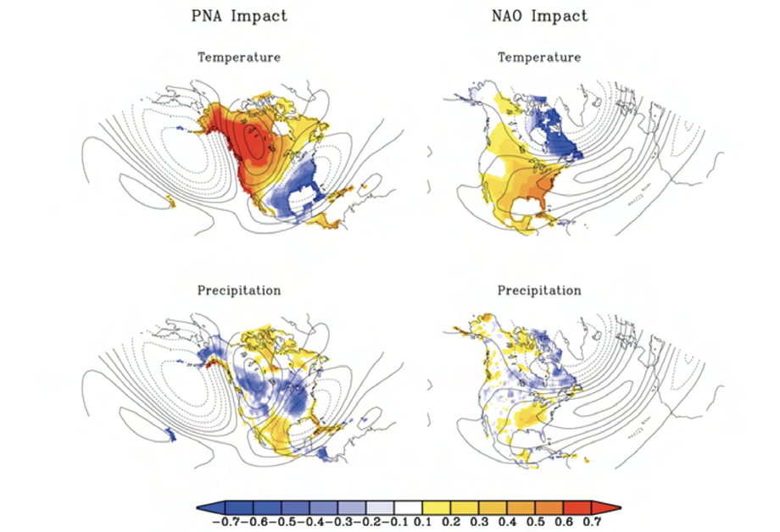
Fundamental Science Questions
These advances have been motivated by fundamental science questions, which guide and drive US CLIVAR activities.
What processes are critical for determining climate variability and change related to the ocean?
What are the connections and feedbacks between oceanic climate variability and other components of the Earth's climate system?
How predictable is the climate on different time and space scales?
What determines regional expressions of climate variability and change?
Source: CCSP SAP1.3
Notes:
Chapter 3. These questions cover a range of climatic issues: from basic understanding of climate processes, to what aspects of the climate system can be predicted on global-to-local scales.

Slide 23
US CLIVAR Goals
  Understand the role of the oceans in climate variability on different time scales.
  Understand the processes that contribute to climate change and variability in the past, present, and future.
  Better quantify uncertainties in the observations, simulations, predictions and projections of climate variability and change.
  Improve the development and evaluation of climate simulations and predictions.
  Collaborate with research and operational communities that develop and use climate information.
Time evolution of annual mean of global sea surface temperature anomaly from ERSST (bar) and HadISST (blue line) for 1950-2011 and OISST (black line) for 1982-2011. Source: BAMS, State of the Climate in 2011
Notes:
Chapter 4. The goals draw attention to the critical issues of scale, modeling, communication, and the characterization and interpretation of uncertainty. Goal 5 is new in that it stresses interactions with other Earth System research communities and the applications community.

Slide 24
Research Challenges
Research Challenges
Societally important topics of interest to the scientific community, funding agencies, and concern most of the CLIVAR Panels, and typically extend US CLIVAR beyond its traditional research agenda
Decadal variability and predictability
Climate and extreme events
Polar climate
Climate and carbon/biogeochemistry
Notes:
Chapter 5. Important to clarify that the research challenges do not comprise the whole of the program, but rather highlight a limited set of climate science topics that are societally important, reflect the interests of the scientific community and funding agencies, and concern most of the CLIVAR Panels.

Slide 25
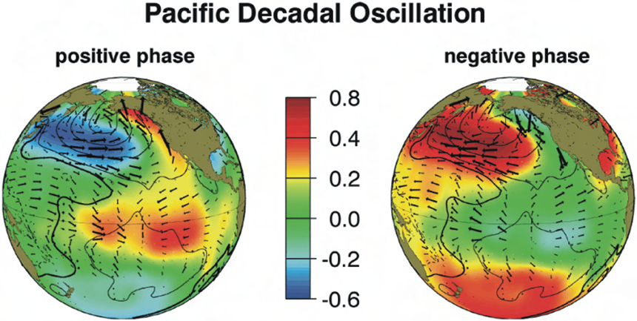
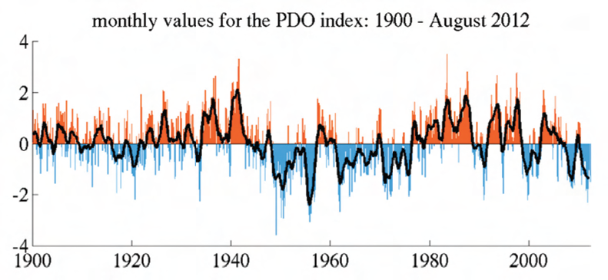
Research Challenges
Research Challenges
Societally important topics of interest to the scientific community, funding agencies, and concern most of the CLIVAR Panels, and typically extend US CLIVAR beyond its traditional research agenda
Decadal variability and predictability
Climate and extreme events
Polar climate
Climate and carbon/biogeochemistry
Source: JISAO/University of Washington
Notes:
Figure caption: (top) Wintertime anomaly patterns of SST (color shading; ºC), sea-level pressure (contours; hPa), and surface wind stress (arrows; longest values ~0.015 N m⁻²) associated with warm (left) and cold (right) phases of the PDO. (bottom) Index of the PDO, defined by the leading principal component (PC) of monthly SST anomalies in the Pacific Ocean north of 20ºN for the 1900−2012 period.

Slide 26
Research Challenges
Research Challenges
Societally important topics of interest to the scientific community, funding agencies, and concern most of the CLIVAR Panels, and typically extend US CLIVAR beyond its traditional research agenda
Decadal variability and predictability
Climate and extreme events
Polar climate
Climate and carbon/biogeochemistry
Notes:
Figure caption: Composites of maximum daily temperatures for cold minus warm ENSO events during DJF from four different climate-model simulations: HadEX2 (top left), CCSM3 Historical (top right), CCSM4 Historical (bottom left), and CCSM4 RCP8.5 (bottom right). For example, maximum temperatures are warmer over much of the US (warm colors) during strong El Niño than during strong La Nina events. Stippled regions pass a 5% t-test. White areas in a) denote grid points with insufficient spatial coverage.

Slide 27
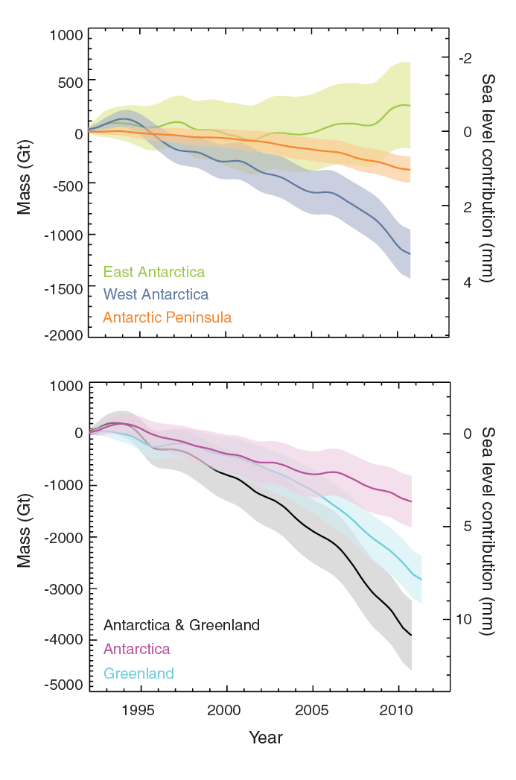
Research Challenges
Research Challenges
Societally important topics of interest to the scientific community, funding agencies, and concern most of the CLIVAR Panels, and typically extend US CLIVAR beyond its traditional research agenda
Decadal variability and predictability
Climate and extreme events
Polar climate
Climate and carbon/biogeochemistry
Sea Level Contributions from Polar Ice Sheets
Source: Shepherd (2012)
Notes:
Figure caption: Cumulative changes in the mass of (left axis) the EAIS, WAIS, and APIS (top) and GrIS and AIS and the combined change of the AIS and GrIS (bottom), determined from a reconciliation of measurements acquired by satellite RA, the IOM, satellite gravimetry, and satellite LA. Also shown is the equivalent global sea-level contribution (right axis), calculated assuming that 360 Gt of ice corresponds to 1 mm of sea-level rise.

Slide 28
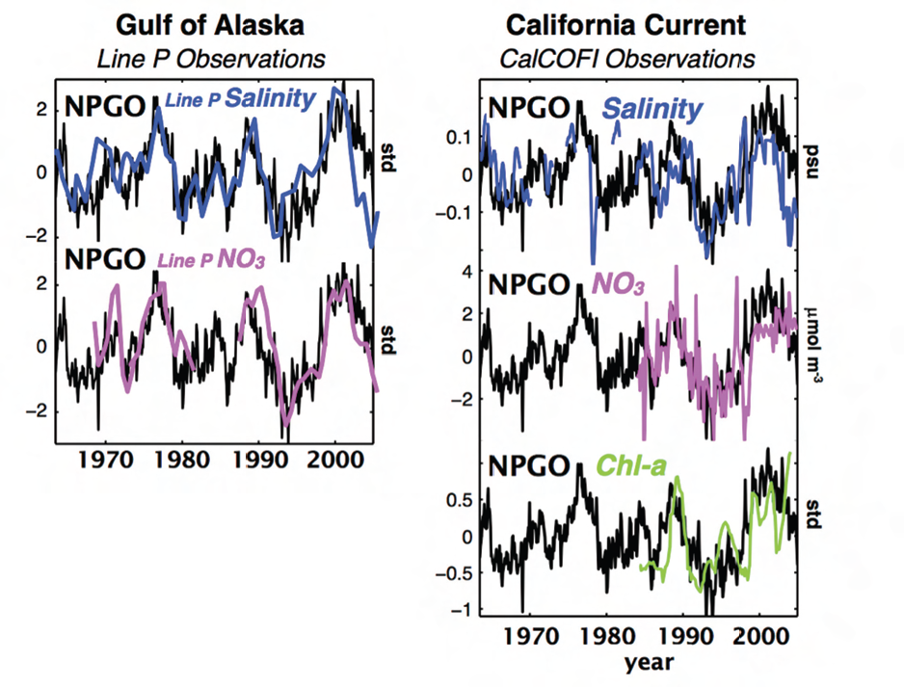
Research Challenges
Research Challenges
Societally important topics of interest to the scientific community, funding agencies, and concern most of the CLIVAR Panels, and typically extend US CLIVAR beyond its traditional research agenda
Decadal variability and predictability
Climate and extreme events
Polar climate
Climate and carbon/biogeochemistry
Notes:
Figure caption: Time series of NPGO index (black) is compared with anomalies in salinity (blue), nitrate concentration (purple), and chlorophyll-a (green) recorded in long-term observations in the Gulf of Alaska and California Current. The close connection between the NPGO index and biological variables is apparent. All times series are plotted in standard deviation units (std) except for nitrate concentration (NO₃ in mole/m³) and salinity (psu). The chlorophyll-a time series is smoothed with a 2-year running average.

Slide 29
Cross-Cut Strategies
Notes:
Chapter 6. Specific types of activities are needed to achieve each of the US CLIVAR science goals. They can be grouped into five distinct Cross-cutting Strategies identified across the top of table. The table summarizes how the cross-cutting strategies outlined in this chapter address each of the US CLIVAR Goals.
Actions for each strategy are provided in the following slides.

Slide 30
US CLIVAR
Interagency Group
Scientific Steering Committee
Project Office
Panels
Phenomena, Observations & Synthesis
Process Study Model
Improvement
Predictability, Prediction & Applications Interface
Science Teams
Working Groups
Atlantic Meridional Overturning
Circulation (AMOC)
Salinity Hurricanes
Madden Julian Oscillation Greenland Ice Sheet/Ocean Interactions
Western Boundary Current ENSO Diversity
Drought Eastern Tropical Ocean Synthesis
High Latitude Surface Fluxes Extremes
Decadal Predictability Ocean Carbon Uptake
Southern Ocean
Climate Process Teams
http://www.usclivar.org
Notes:
Organizational structure of program. Management bodies in blue, implementation panels in green, funded implementation activity teams/groups in purple.

Slide 31
Implementation Approaches
US CLIVAR will achieve its goals through PI participation in:
Science Teams
  Interagency established PI group; coordinate projects; annual meeting & report; 5-10 year duration
Working Groups
  Grassroots small group on specific topic; produce products for community; 2-3 year duration
Climate Process Teams (CPTs)
  Agency funded projects assembling observationalists and model developers to advance specific process representation/parameterization in GCMs; 3-5 year duration
Science Meetings/Workshops
  Community organized on relevant topics
Agency-supported Research Calls
  Implementing coordinated observation and data projects; field campaign and process research; modeling, prediction and applications projects
Opportunities for Students, Postdocs, and Early-career Scientists
  Participation emphasized in above activities; assistance for attending meetings
Notes:
These approaches have been developed and employed over the lifetime of U.S. CLIVAR, having proven effective in organizing community and multi-agency sponsored research. These approaches offer opportunity for direct participation of scientists in the program.

Slide 32
Program Cooperation & Coordination
Engagement of of US and International programs and infrastructure
USGCRP
  Land surface hydrology and terrestrial ecosystem impacts research
  Carbon cycle, ocean biogeochemistry and marine ecosystem research
  Atmospheric aerosol-cloud interactions
  Polar and cryospheric research
WCRP
  International CLIVAR
  Global Energy and Water Exchanges (GEWEX)
  Climate and Cryosphere (CLIC)
  Stratospheric Processes and their Role in Climate (SPARC)
Enabling Infrastructure
  Sustained observing systems
  Data centers
  Ship and aircraft
  Modeling centers and high-performance computing
  Operational and real-time information centers
  International and US national climate change assessments
Notes:
Chapter 8. U.S. CLIVAR seeks active engagement with other Earth-science communities, both within the U.S. and internationally. This engagement will foster activities that address shared science questions at the interface of traditional disciplinary program boundaries.
The collaborations that are envisioned target important areas of infrastructure to which U.S. CLIVAR contributes and upon which the program relies.

Slide 33

Core Climate Science Contribution to USGCRP
US Global Change Research Program
Advance Science Goal
Integrated Observations
Integrated Modeling
Earth System Understanding
Climate Dynamics
Biogeochemisty/Carbon Cycle
Ecosystems & Biodiversity
Freshwater Resources
Human Systems & Social Drivers
Choices and Responses
Adaptation & Mitigation Science
Information Management
Notes:
US CLIVAR is a component program of the USGCRP, organizing research on the role of the ocean in climate.
US CLIVAR contributes to the USGCRP advance science goal, specifically to integrated observations, integrated modeling, and Earth system understanding – most readily contributing to understanding of climate dynamics and fostering collaboration on biogeochemistry, carbon cycle, ecosystems, water resources, and human system impacts.
Interaction through SSC briefings of Subcommittee on Global Change Research, IAG manager participation on USGCRP Working Groups, and regular communication between program offices.

Slide 34
US Contribution to International CLIVAR
International
Focused & Integrated Research Opportunities
Predictability of monsoon systems
Decadal climate variability and predictability
Biophysical interactions and dynamics of upwelling systems
Dynamics of regional sea level variability
Prediction and attribution of extreme events
ENSO in a warmer climate
Ocean heat storage
…
Notes:
U.S. CLIVAR is the U.S. contribution to International CLIVAR, which provides the forum for collective multi-country planning and implementation of research on the role of the ocean in climate variability and predictability.
The mission, objectives, and research opportunities of International CLIVAR align with those of the US, albeit with somewhat different structure. US CLIVAR is thus well poised to contribute to international program objectives and link with efforts of other countries doing the same. U.S. CLIVAR indeed evolves in the context of the international program, being both influenced by new and emerging research directions internationally, and influencing the directions of the international program.
Collaboration of the U.S. program with the WCRP and its other three programs is principally through the International CLIVAR interface.

Slide 35
Thank You clivar.org usclivar.org

