Slide 1
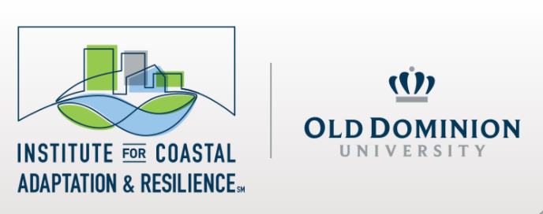



Center for Coastal Physical Oceanography
Quantum-enhanced feature engineering for hurricane rapid intensification prediction via classical shadow protocols
Andrew Maciejunes, Dr. Ross Gore, Dr. Arkaitz Rodas Bilbao, and Dr. Tal Ezer
Old Dominion University, Norfolk VA, USA

Slide 2


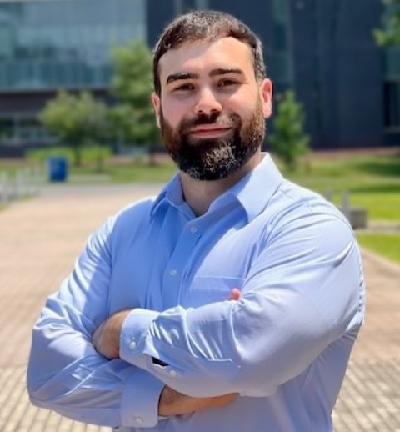
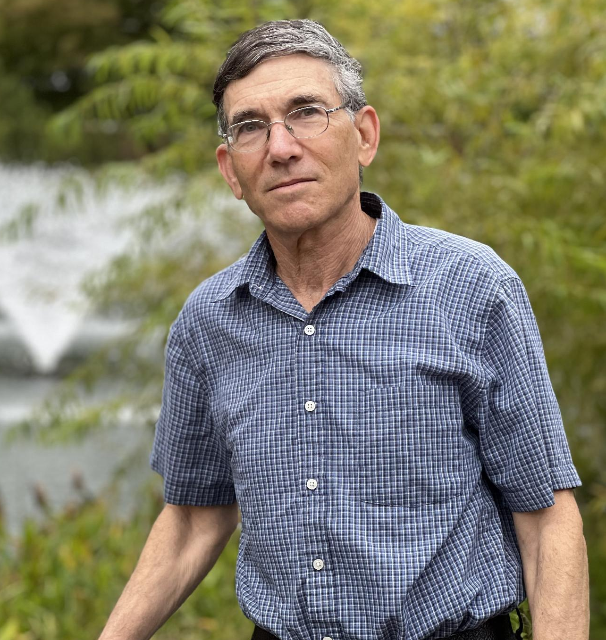
Meet the Team
Andrew Maciejunes is a graduate physics student researching quantum machine learning and quantum optimization, with a focus on near-term quantum computing.
Ross Gore is a research associate professor researching data science and predictive analytics, with a focus on decision-support modeling for public health and risk.
Arkaitz Rodas Bilbao is an assistant professor of physics researching lattice QCD and hadron spectroscopy, with a focus on AI and machine learning applications in nuclear physics.
Tal Ezer is a professor of ocean and earth sciences researching ocean circulation and climate change, with a focus on sea-level rise and coastal flooding.

Slide 3

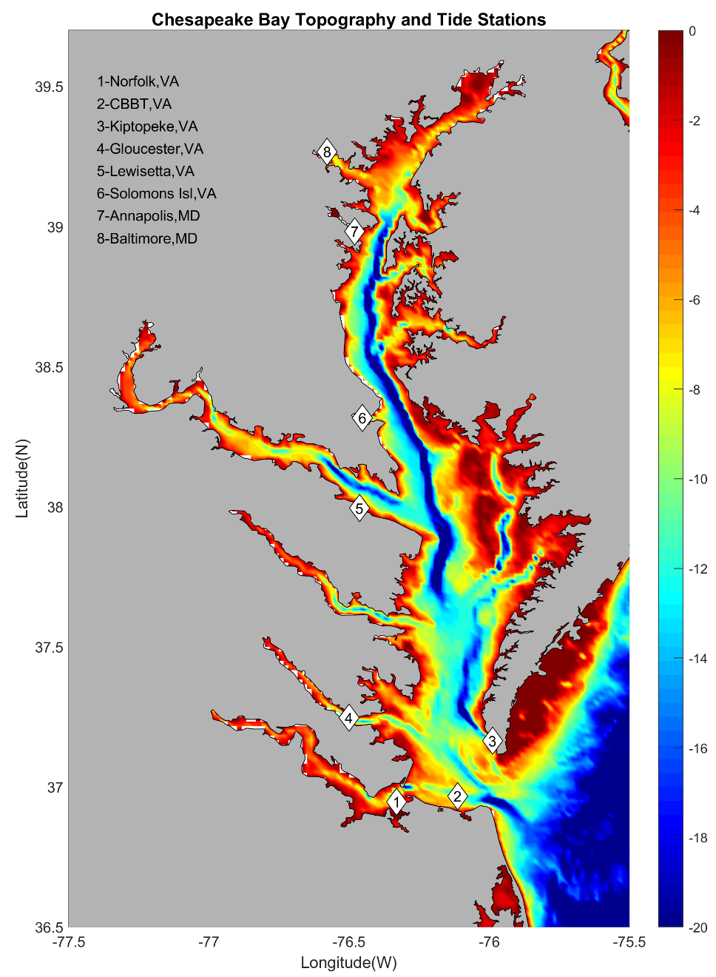
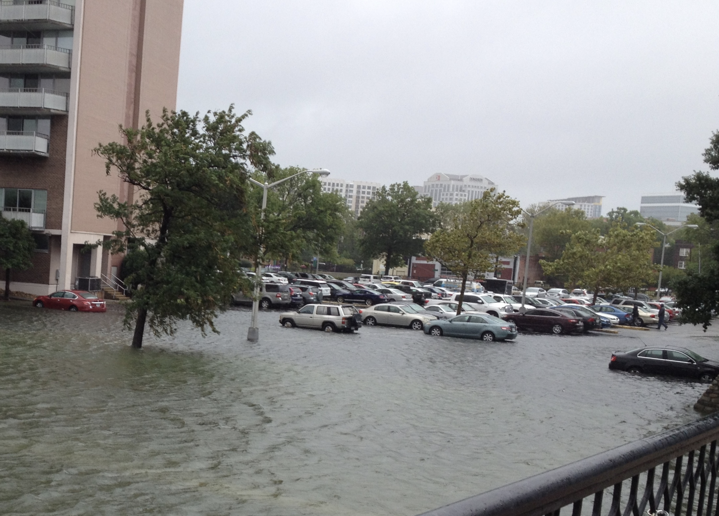
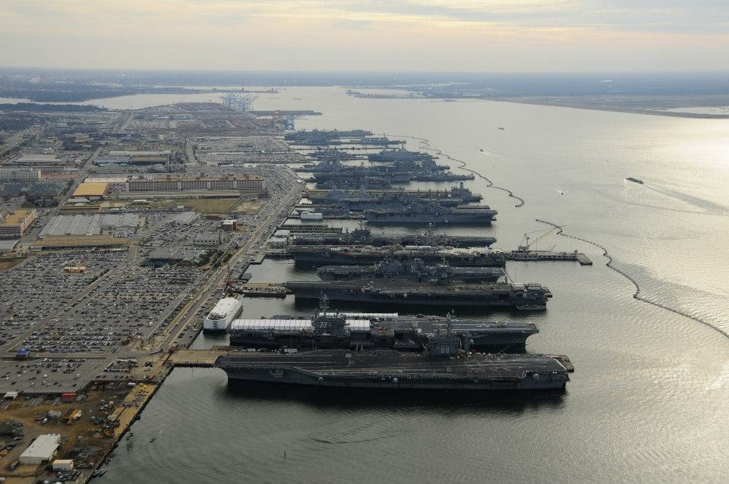
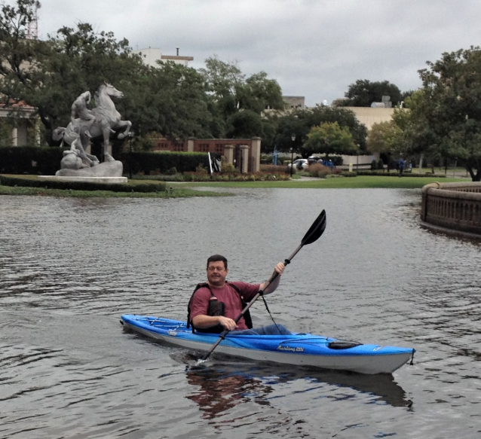
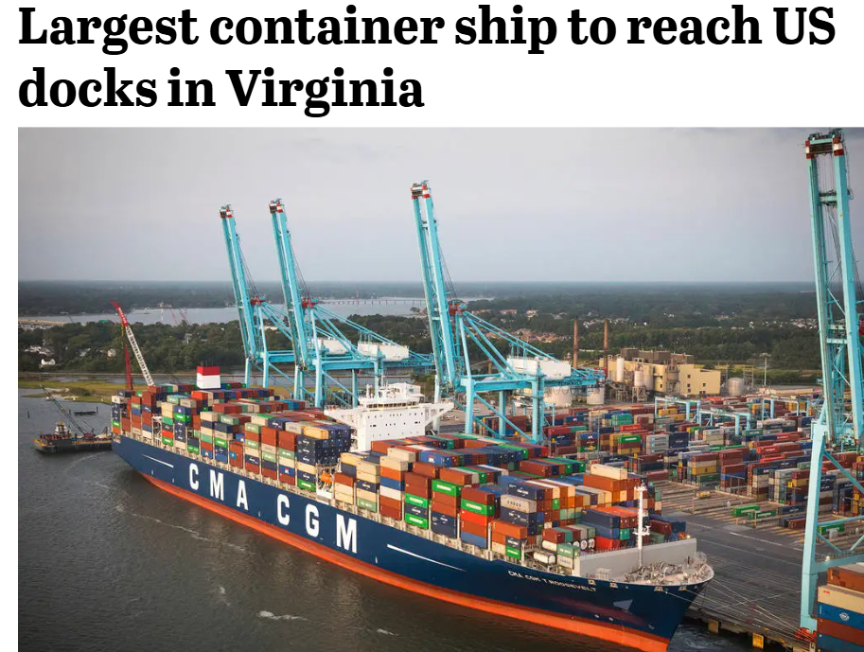
Norfolk Virginia is a port city on the shores of the largest estuary of the US (Chesapeake Bay)
It is one of the US cities with the highest risk for flooding due to sea level rise, land subsidence, and storm surges
Chesapeake Bay, US
Flood in Norfolk, USA
Baltimore
Washington
🡨museum
street
Atlantic Ocean
Norfolk, VA

Slide 4
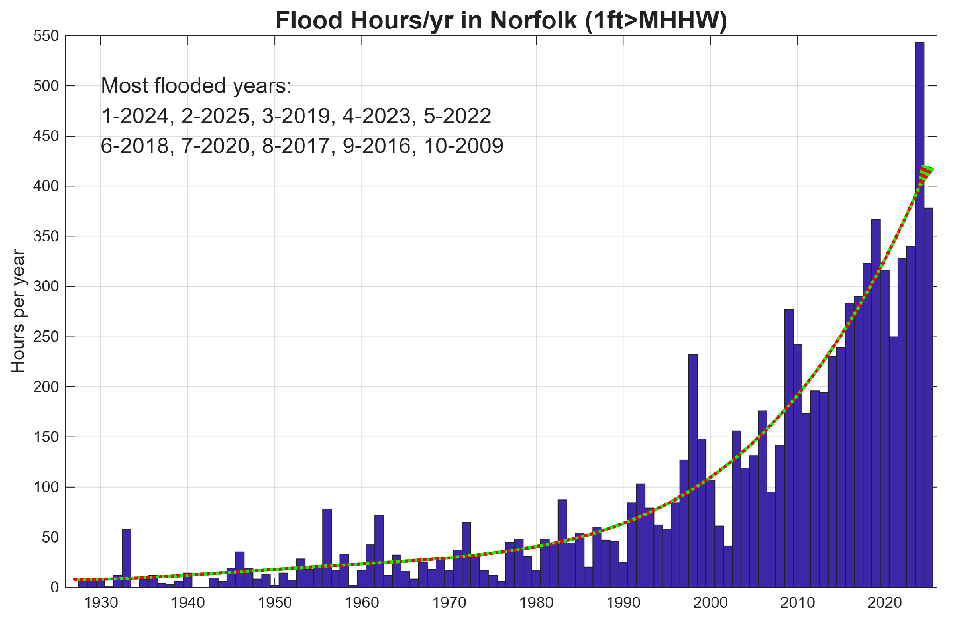
storm surge from hurricanes & tropical storms
sea-level rise impact

Slide 5
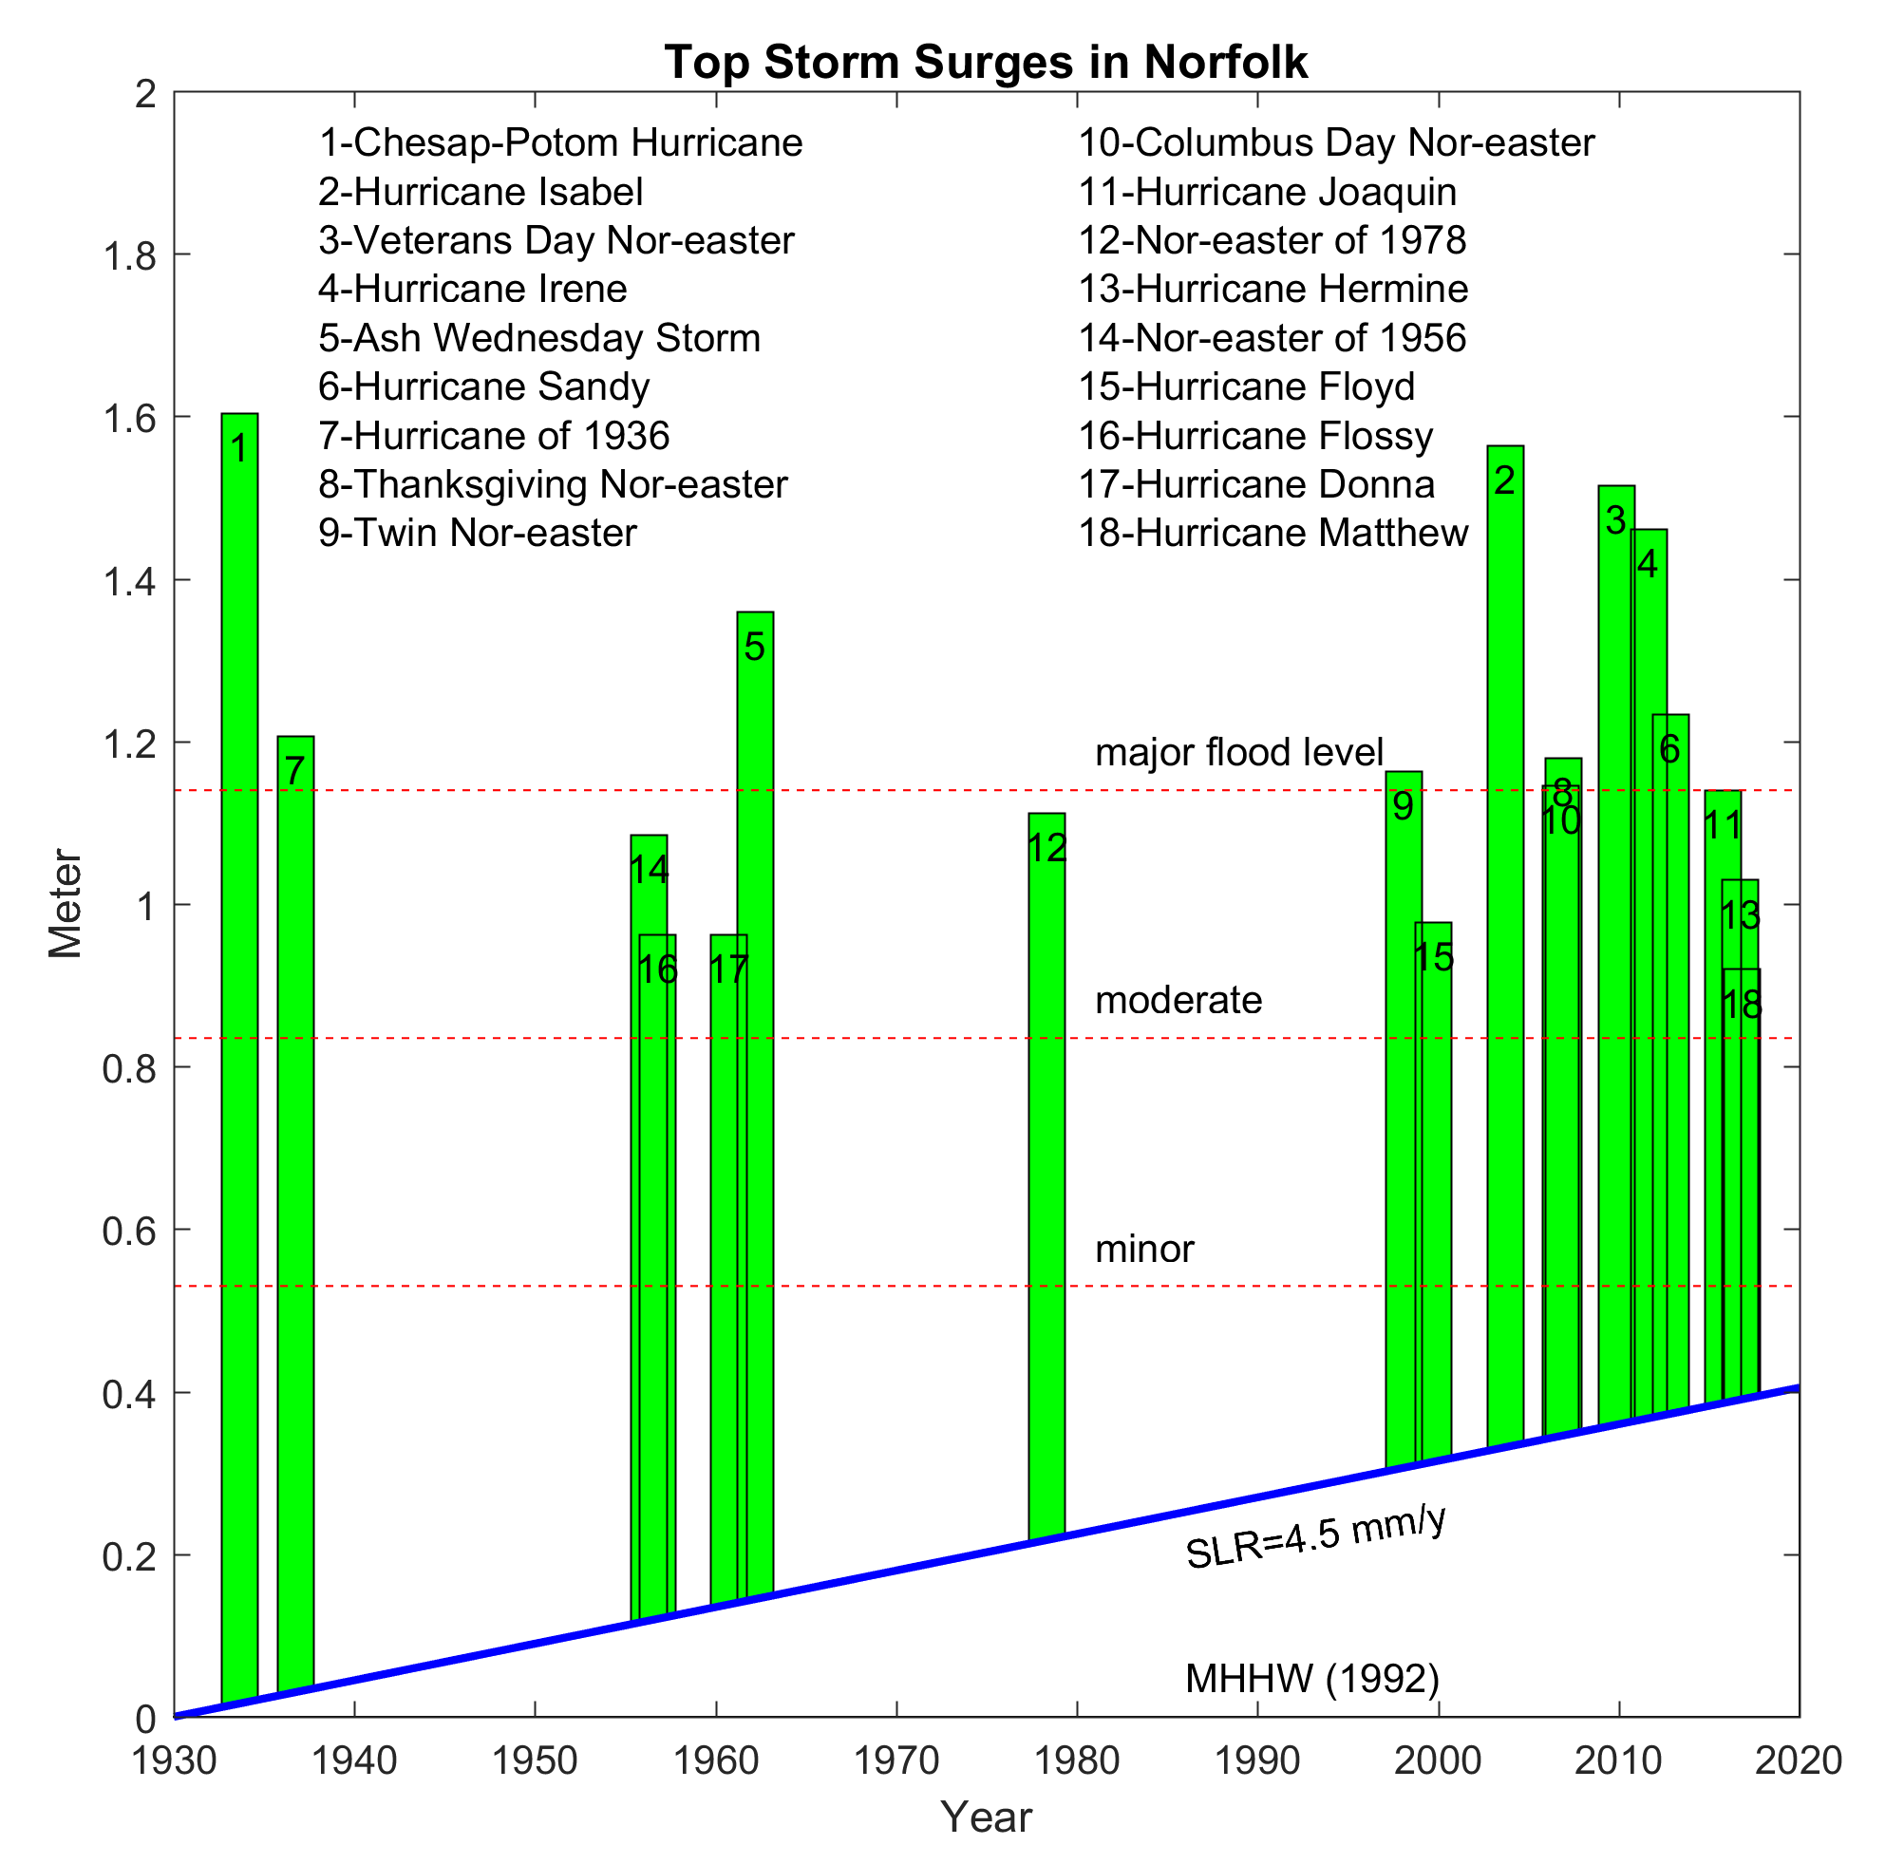
More storm surges in recent years
with sea level rise.
Even weak storms can now cause flooding.

Slide 6
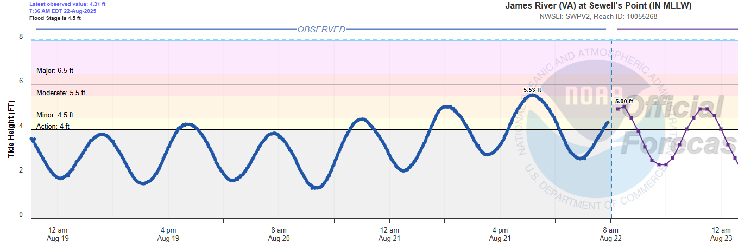
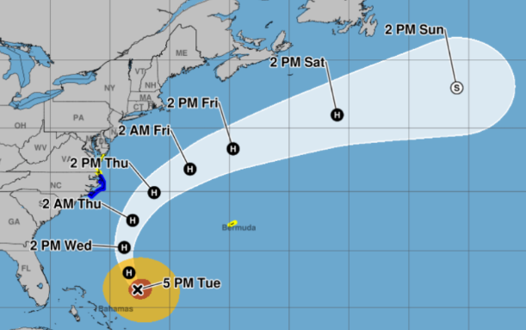
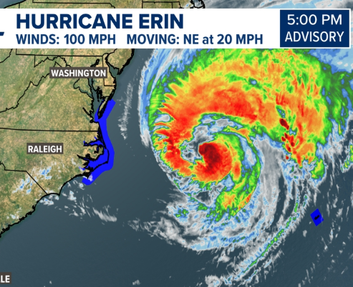
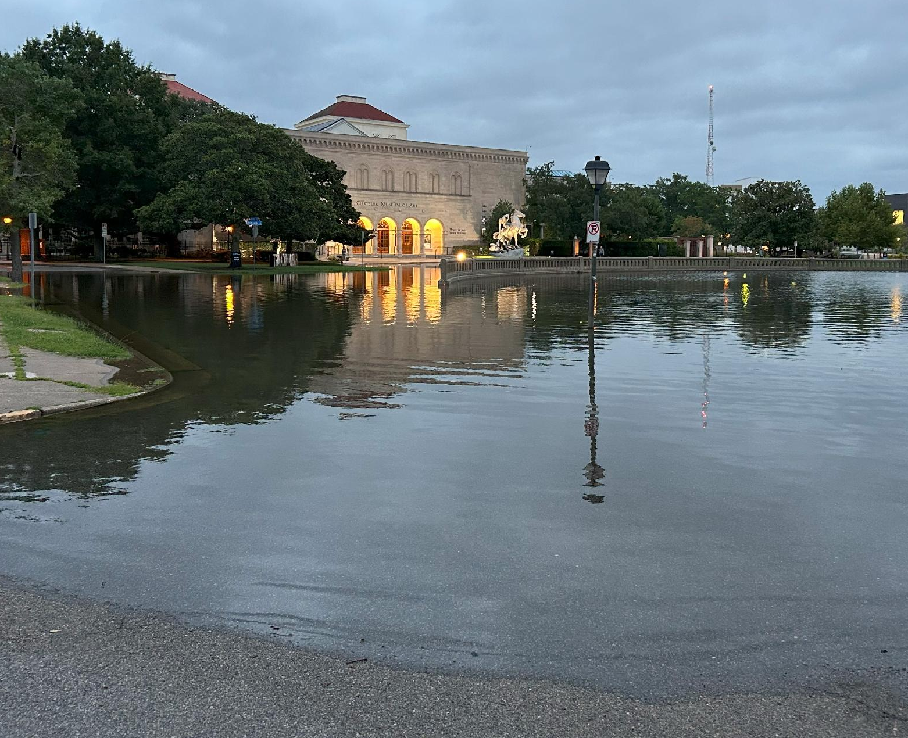
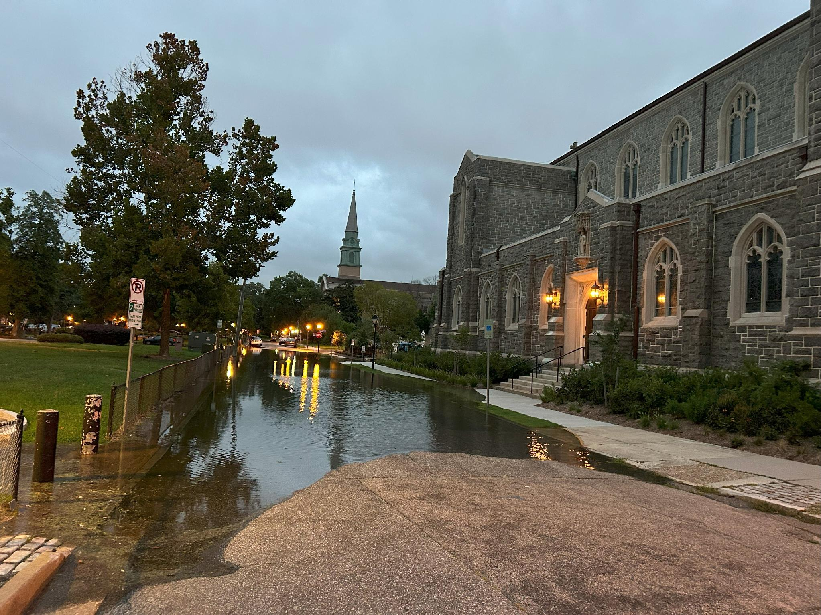
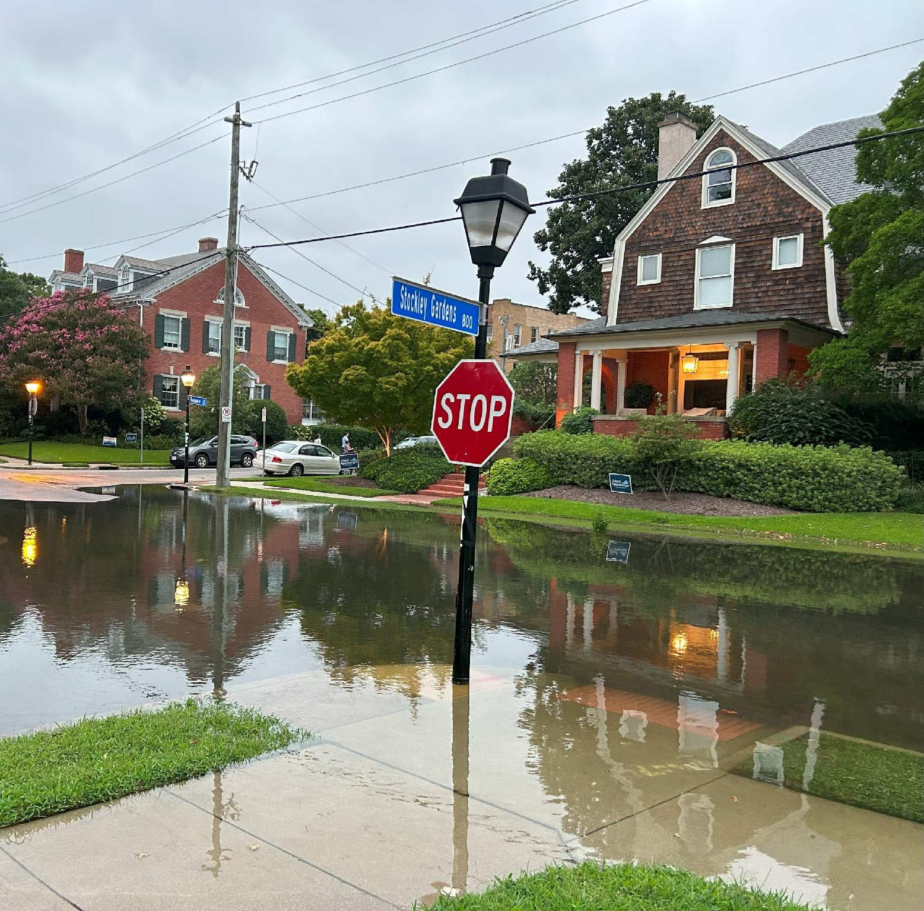
Impact of Hurricane Erin
August 21, 2025, 9pm 🡪
The Ghent historic district of Norfolk (pictures by T.Ezer)
Chrysler Museum of Art
Old churches
Residential area
Norfolk🡪
~1000km

Slide 7
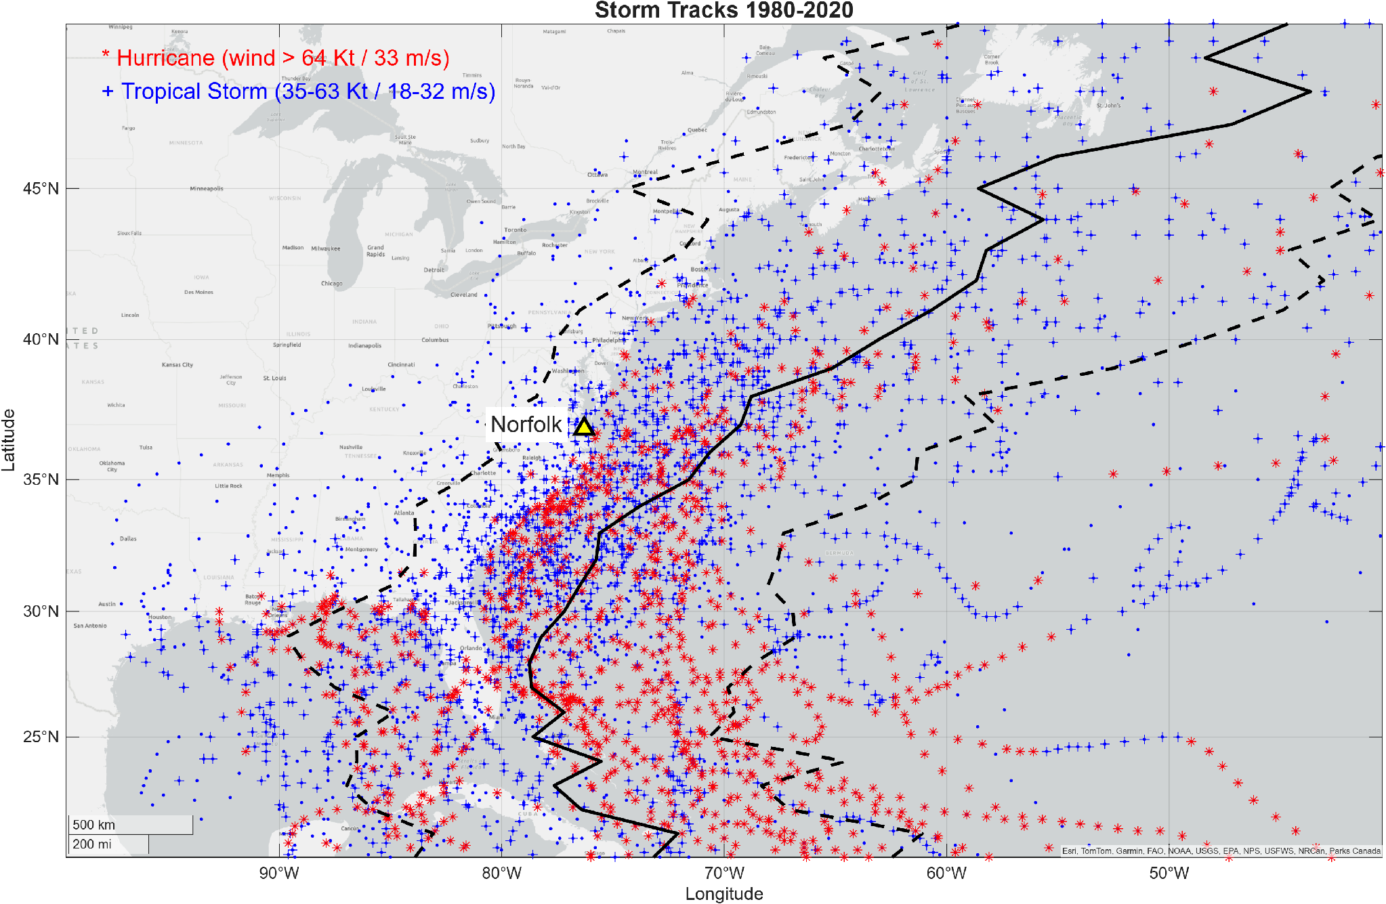
Hurricanes and Tropical Storms (HURDAT2 1980-2025)
Our Goal
Accurately predict flooding (≥0.60m) from Norfolk area storm-track features alone 24 hours before it occurs.
This helps decision makers in planning.

Slide 8
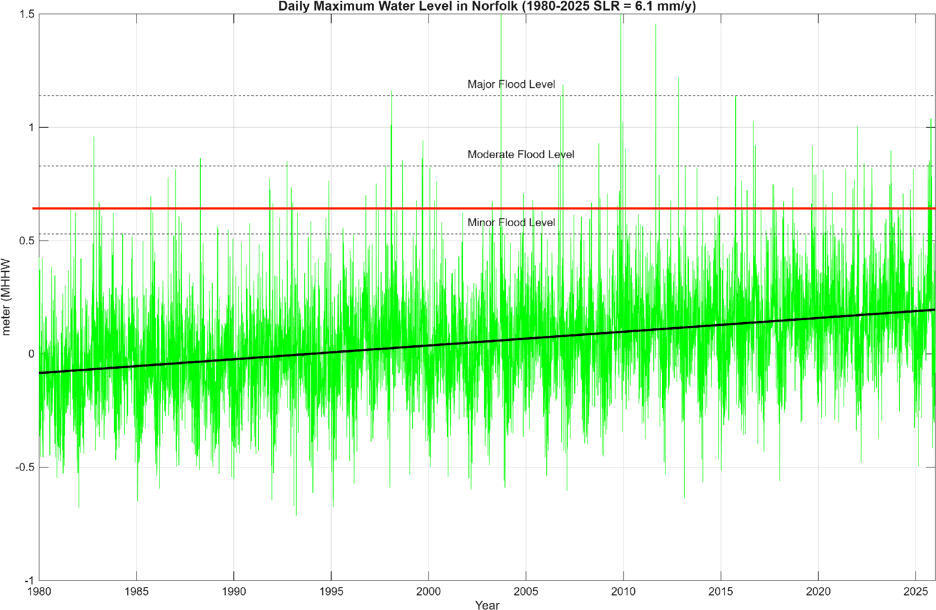
Why flooding defined at (≥0.60m)?

Slide 9
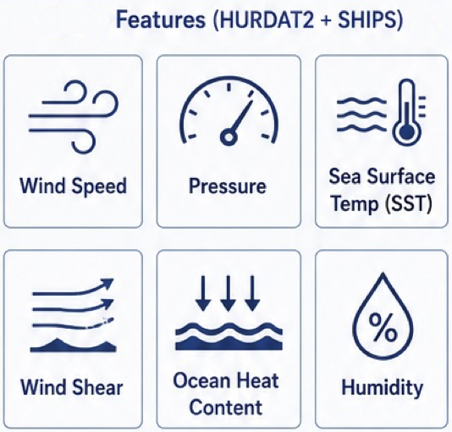
Quantum-Augmented Machine Learning (ML)
1. Label: Match each HURDAT2 storm observation to Norfolk 24 hour later water-level. Flooding is defined by a WL ≥ 0.60m.
2. Classical and quantum features: wind, pressure, SST, shear, ocean heat content, humidity (6 features from HURDAT2 + SHIPS).
3. ML Model comparison: Logistic Regression, Gradient Boosting, Neural Network. Classical-only vs. classical + quantum features.
4. Validation: 80/20 train vs. test split, 5-fold cross-validation.

Slide 10
Three Ways to Bring Quantum Computing into Machine Learning
OVERVIEW
METHOD
TRAINING
DEPLOYMENT
KEY DIFFERENCE
1
Classical ML
Model
Prediction
Quantum Computer Needed Never
No quantum, anywhere
Data
Classical
New data
Classical
Classical baseline
2
Naive Quantum
Model
Prediction
Quantum computer needed for every prediction
Online feature extraction
Data
Quantum
New data
Quantum
Improved accuracy
3
LUQPI
Quantum
+
Model
Prediction
Quantum computer used only once, during training
Quantum-privileged training
Data
Classical
New data
Classical
Potentially Improved efficiency and accuracy!
Data
Ordinary computer
Quantum computer

Slide 11
Classical Machine Learning
1
TRAINING
DEPLOYMENT
Trained
Model
Prediction
Training
examples
Ordinary
computer
New
example
Ordinary
computer
HOW IT WORKS
FORMAL FRAMING
Learns from labeled data.
Serves as the classical baseline that any quantum method must outperform to matter.
In PAC-learning terms: a classical ML algorithm sees examples and outputs a hypothesis h that is correct with high probability.
Data
Ordinary computer
Quantum computer

Slide 12
The Naive Quantum Approach
2
TRAINING
DEPLOYMENT
Trained
Model
Prediction
Atom-chain
settings
Quantum
computer
New atom-chain
settings
Quantum
computer
HOW IT WORKS
FORMAL FRAMING
A quantum feature map turns each input into quantum-derived features.
Recomputed for every new input at deployment.
Because the map must run again for each prediction
Quantum computer has to stay available indefinitely, not just during training.
The feature map is evaluated at both training and deployment time, so quantum resources are required for the lifetime of the model.
Data
Ordinary computer
Quantum computer

Slide 13
LUQPI: Learning Under Quantum Privileged Information
3
TRAINING
DEPLOYMENT
+
Trained
Model
Prediction
Training
examples
Quantum
hints
Ordinary
computer
New
example
Ordinary
computer
HOW IT WORKS
FORMAL FRAMING
During training only.
A classical algorithm uses those features to judge which examples are inherently hard to classify, and refines accordingly.
At deployment, the model uses only the ordinary input. The quantum step is never repeated.
Requires formal PAC Hardness
LUQPI adapts “Learning Under Privileged Information” to the quantum setting. Quantum only during training.
Data
Ordinary computer
Quantum computer

Slide 14
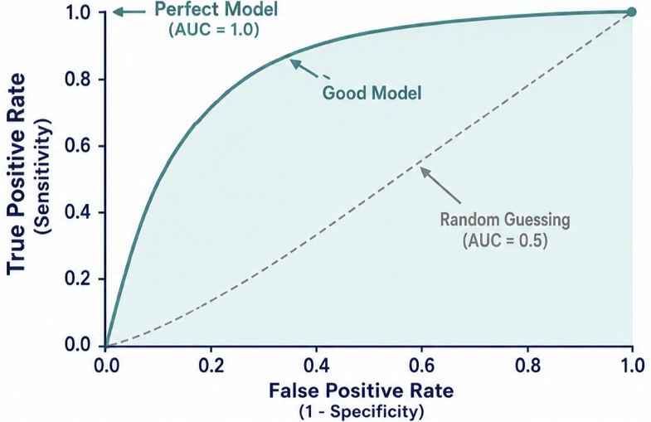
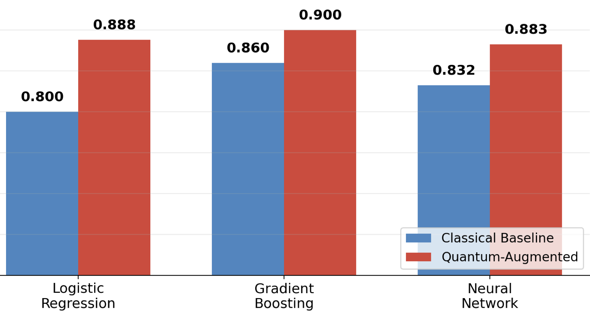
Evaluation
How accurately can we predict if flooding (≥0.60m) from Norfolk area storm-track features alone 24 hours before it occurs.
What is AUC?
Measure Accuracy of 3 types of ML Models:
Logistic Regression
Gradient Boosting
Neural Network
AUC: Classic vs Quantum

Slide 15
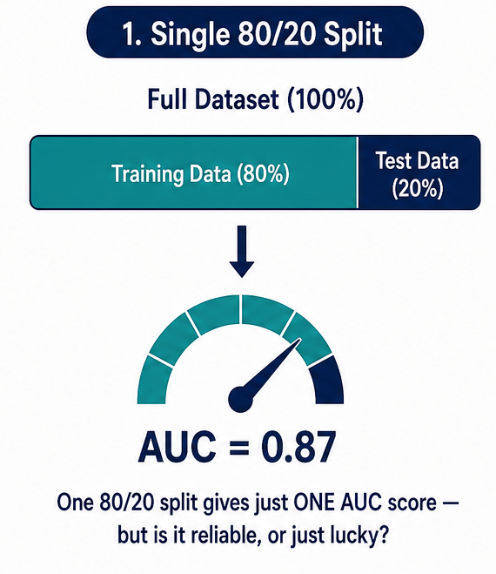
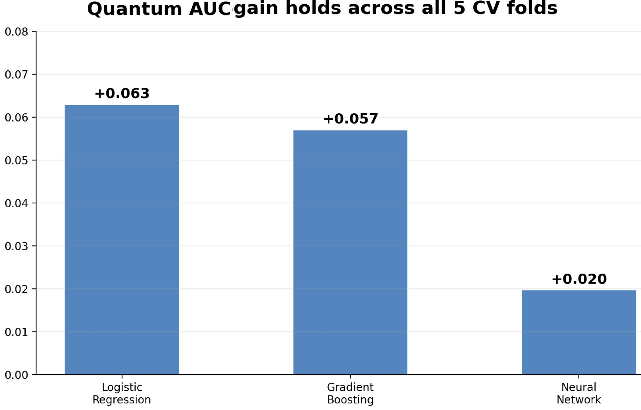
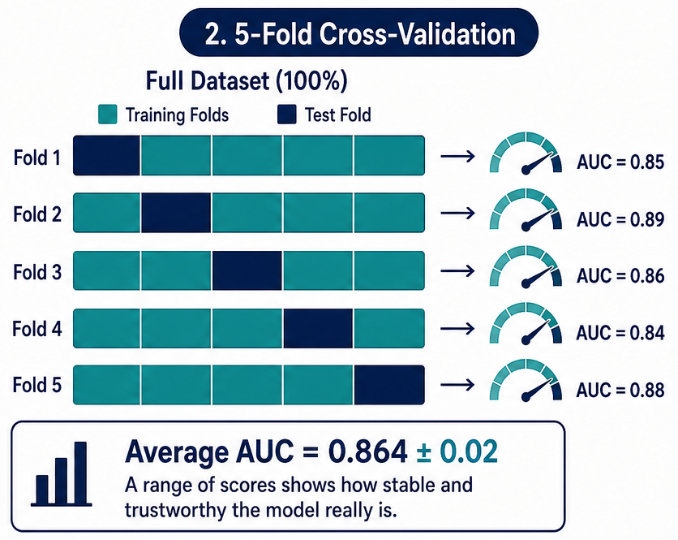
Average Improvement Provided by Quantum Approach
From Previous Slide
Cross-folds to see how robust that is

Slide 16
Key Takeaways
Why this work matters for Norfolk (and other coastal cities)
Norfolk is on the front line of coastal flooding.
1
Rising seas, sinking land, and increasingly powerful storm surges combine to make it one of the most flood-vulnerable cities in the country.
Earlier, more accurate warnings save lives and property.
2
The goal is to predict severe flooding a full 24 hours in advance, using only storm-track data available before landfall.
That lead time is a decision-making tool.
3
More reliable warnings give emergency planners, city officials, and residents more time to evacuate, stage resources, and protect infrastructure.
The approach is validated and ready to build on.
4
Tested through cross-validation and bootstrap analysis, this gives Norfolk — and other flood-prone coastal communities — a practical foundation for better storm preparedness.

Slide 17

THANK YOU!

Slide 18
Bibliography
Ezer, Tal. "Sea level acceleration and variability in the Chesapeake Bay: past trends, future projections, and spatial variations within the Bay." Ocean Dynamics 73, no. 1 (2023): 23-34.
Ezer, Tal. "A demonstration of a simple methodology of flood prediction for a coastal city under threat of sea level rise: The case of Norfolk, VA, USA." Earth's Future 10.9 (2022): e2022EF002786.
Ezer, Tal, and Larry P. Atkinson. "Accelerated flooding along the US East Coast: On the impact of sea‐level rise, tides, storms, the Gulf Stream, and the North Atlantic Oscillations." Earth's Future 2.8 (2014): 362-382.
Bokov, Vasily, et al. "Machine learning with minimal use of quantum computers: Provable advantages in Learning Under Quantum Privileged Information (LUQPI)." arXiv preprint arXiv:2601.22006 (2026).
Barati, C. Nicolas, et al. "Challenges in applying quantum optimization to agent-based modeling: A Schelling segregation case study." SIMULATION (2026): 00375497261467053.
Maciejunes, Andrew, et al. "Polynomial Resource Classification of Quantum Circuit Familes via Classical Shadows." arXiv preprint arXiv:2604.25708 (2026).

Slide 19
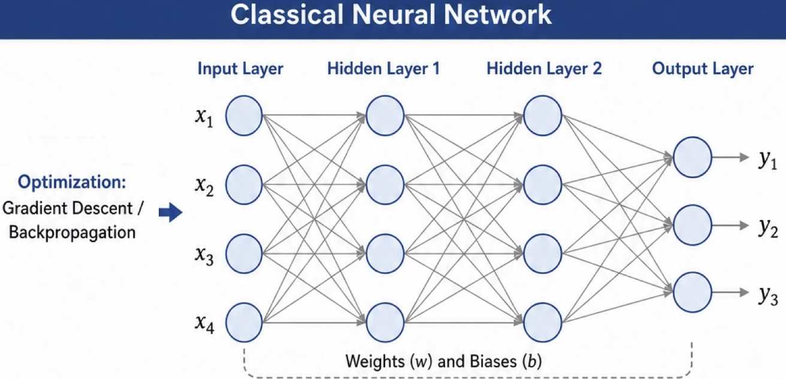
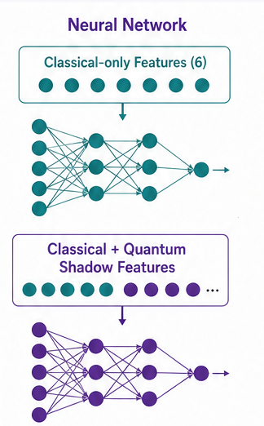
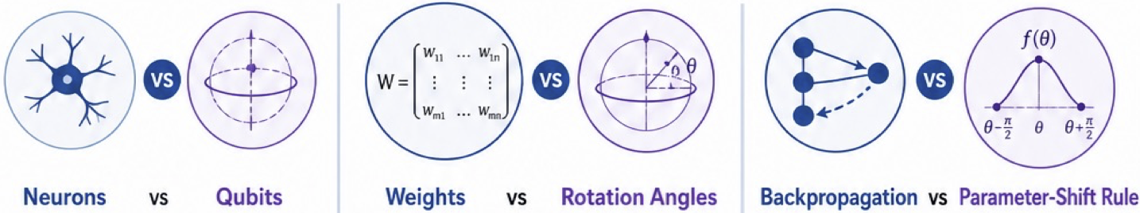
What these differences look like for Neural Networks
Structural Differences: Classic vs Quantum

